Slide 1
Lecture 4.2 First Degree Price discrimination

Slide 2
Price discrimination
Price discrimination (PD): selling the same/similar good at different prices to different customers.
Price discrimination manifests in many ways:
Different prices for different groups of customers (e.g. student/senior discounts, purchase history dependent prices)
Quantity/bulk discounts; Selling a package of products at a discounted price
Offering different “versions” of a product/service (e.g., economy class vs. business class)
Varying prices over time (e.g. the prices of movies, books, and video games often decline over time; sales and fluctuating prices)
Crucial point: these price differences arise because of differences in demand, not the costs of serving the consumers.

Slide 3
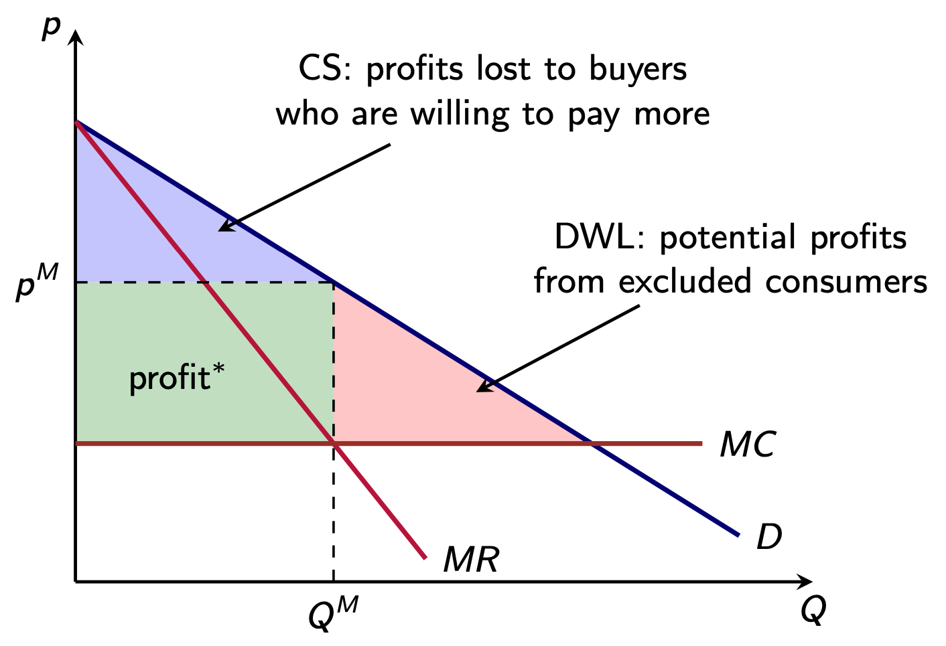
Price discrimination
Motivation :

Slide 4
First degree price discrimination
What if you have heterogeneous customers, each with their own willingness to pay?
Simply charge willingness to pay for each customer. This is first degree price discrimination.
The firm extracts all surplus.
Market efficiency is improved. There is no deadweight loss.
Is it ever feasible?
Requires complete information about tastes and willingness to pay.

Slide 5
Price ($)
The demand curve can be interpreted as a willingness to pay curve. The height of the demand curve gives the WTP of each buyer.
500,000
Charge $490k to the first buyer
490,000
480,000
Charge $480K to the second buyer etc
To the penultimate and final buyer, charge their willingness to pay of $55k and $50k respectively
50,000
0
Quantity
0
45

